Slide 1
Sales Performance Analysis Report
Rizki Darmawan
03 February 2023

Slide 2
OUTLINE
Executive Summary
Introduction
Methodology
Results
Visualization
- Charts & Dashboard
Discussion
- Findings & Implications
Conclusion
Appendix

Slide 3
EXECUTIVE SUMMARY
The Women's E-Commerce Clothing market is a rapidly growing sector within the e-commerce industry, driven by the increasing demand for convenient and accessible online shopping experiences. This report provides a comprehensive analysis of the one of the women's e-commerce clothing market, including trend sales, growth rate, and demand product. Our findings indicate that SKUs 799 and color dark blue have the highest sales and overall sales have consistent increased compared to previous month. The report concludes with recommendations for data-driven strategies to increase customer acquisition and retention.

Slide 4
INTRODUCTION
The women's e-commerce clothing market is a rapidly growing segment within the broader e-commerce industry. With increasing internet penetration and the convenience of online shopping, more and more women are turning to the web to purchase their clothing and fashion items. The women's clothing market offers a significant opportunity for businesses to reach a large and growing customer base, as women of all ages and backgrounds seek the latest fashion trends and styles. This report provides a comprehensive overview of the one of the women's e-commerce clothing market, including market size, and growth rate. Through an analysis of market trends and consumer demand, this report aims to help businesses understand the opportunities and challenges of the women's e-commerce clothing market and make informed decisions about how to effectively target and serve this important customer segment.

Slide 5
DEFINING PROBLEMS
What are the best and worst-selling SKU items? by color? by size?
What are the peak days or time periods with the highest sales? Do sales follow a trend or a seasonality?

Slide 6
METHODOLOGY
The data for this report was obtained from the kaggle. The following steps were taken to analize the data:
Data Collection: Sales data for the past year (June to December 2022) was downloaded from the kaggle as a csv file.
Data Cleaning: The data was thoroughly checked for missing values, duplicates, and inconsistencies. Any discrepancies were corrected to ensure accurate analysis.
Data Exploration: Descriptive statistics were used to understand the general characteristics of the data. Graphs and charts were used to visually represent the data and identify trends and patterns.
Data Analysis: The data was analized to determine the overall sales performance. Growth rates were calculated and compared to the previous month.
Recommendations: Based on the findings from the data analysis, recommendations were made to maximize sales growth and improve the company's performance.
The data and analysis in this report are based on the information available at the time of writing. Further analysis and refinement may be required in the future as new data becomes available.

Slide 7
RESULTS
The highest performing SKUs is 799 and color is dark blue.
Overall sales have increased compared to previous month
The highest sales growth rate occurred in August 33,02% and the highest revenue occurred in September with total 46k
The graph of sales by days/times shows seasonal trends.

Slide 8
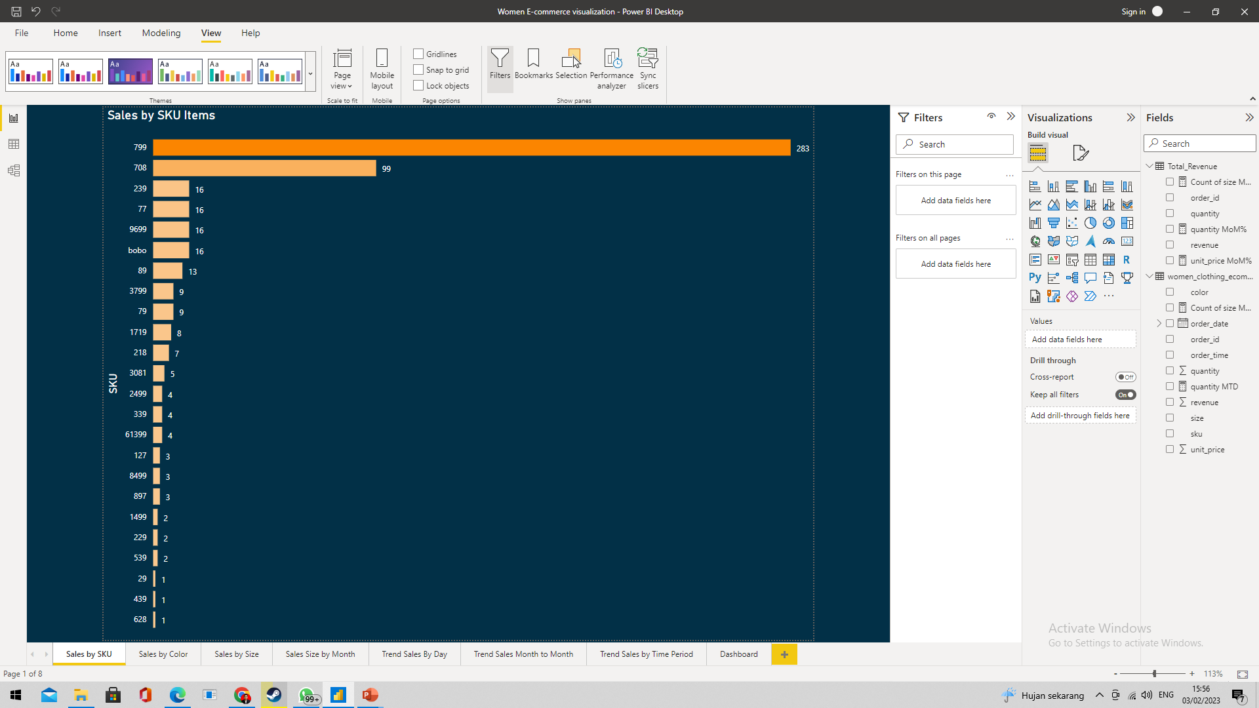
SALES PERFORMANCE BY SKU ITEMS - FINDINGS
Best SKU item(s):
SKU 799, 708: The bar for SKU 799 is the longest on the chart followed by SKU 708, indicating that it has the highest sales among all the SKUs.
Worst SKU item(s):
SKU 29, 439, 628: The bar for SKU 29, 439, 628 is the lowest on the chart, indicating that it is performing poorly in terms of sales.

Slide 9
BEST SALES BY SKU ITEMS - RECOMMENDATION
Based on the finding that the bar for SKU 799 and 708 is the longest on the chart, indicating high sales performance, the following recommendations can be made:
Expand the Product Line: Consider expanding the product line for SKU 799 and 708 to include complementary products or product variations to increase sales and revenue.
Invest in Marketing: Continue to invest in marketing efforts for SKU 799 and 708 to increase brand recognition and maintain high demand for the product. This could involve targeted advertising, social media campaigns, and product demonstrations.
Monitor Competitors: Regularly monitor competitors to ensure that the company remains competitive in terms of product quality, price, and marketing efforts.
These recommendations aim to capitalize on the high sales performance of SKU 799 and 708 and maintain its market leadership position. By implementing these strategies, the company can increase its revenue and improve its overall performance.

Slide 10
WORST SALES BY SKU ITEMS - RECOMMENDATION
Based on the finding that the bar for SKUs 29, 439, and 628 is the lowest on the chart, indicating poor sales performance, the following recommendations can be made:
Market Research: Conduct market research to understand the demand for these products and the factors contributing to their poor sales performance. This could involve surveying customers, analyzing competitor products, and reviewing product pricing.
Re-evaluate Product Positioning: Based on the market research, re-evaluate the positioning of these products in the market. Consider revising their target audience, product features, and marketing strategy to better align with customer needs and preferences.
Adjust Pricing Strategy: Review the pricing strategy for these products to determine if they are priced competitively or if a price adjustment is needed to increase sales.
Consider Discontinuing: If the market research and re-evaluation of product positioning and pricing strategy do not result in improved sales performance, the company may want to consider discontinuing these SKUs to reduce inventory costs and focus resources on more successful products.

Slide 11
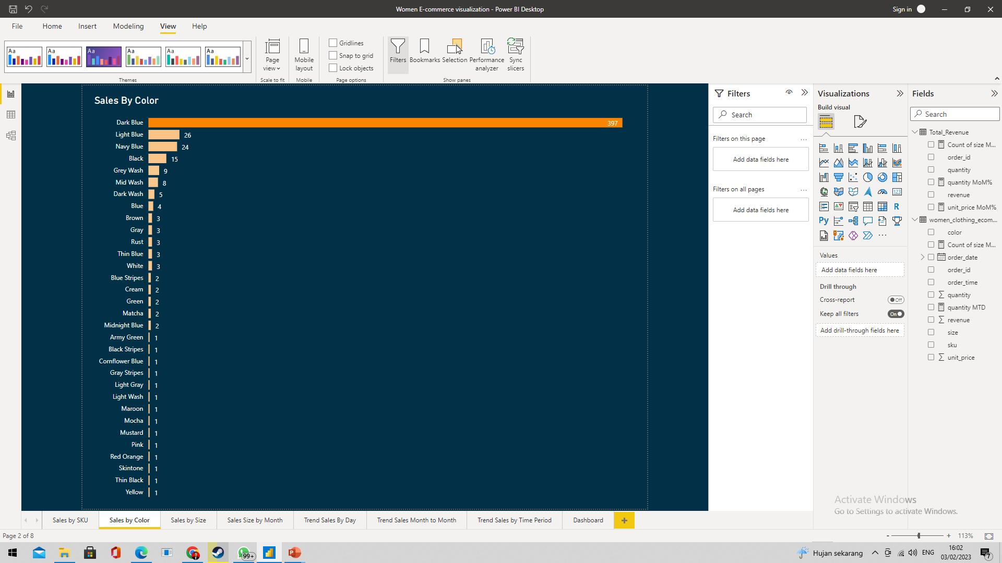
SALES PERFORMANCE BY COLOR - FINDING
Best sales by color:
Dark Blue: The bar for dark blue is the longest on the chart, indicating that it has the highest sales among all the colors. The company may Consider expanding the product line for dark blue to include complementary products or product variations to increase sales and revenue.

Slide 12
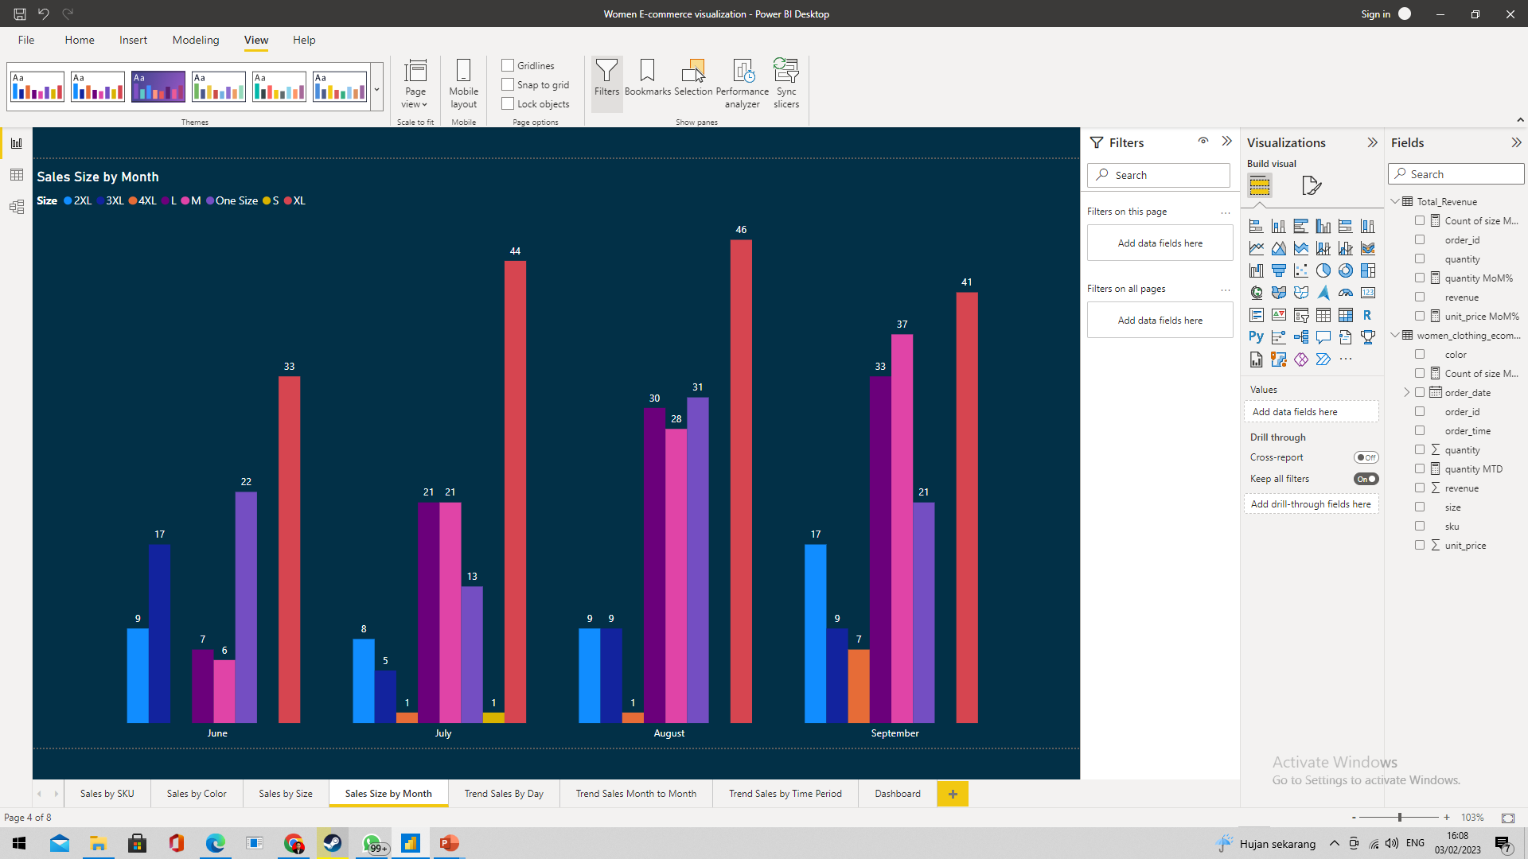
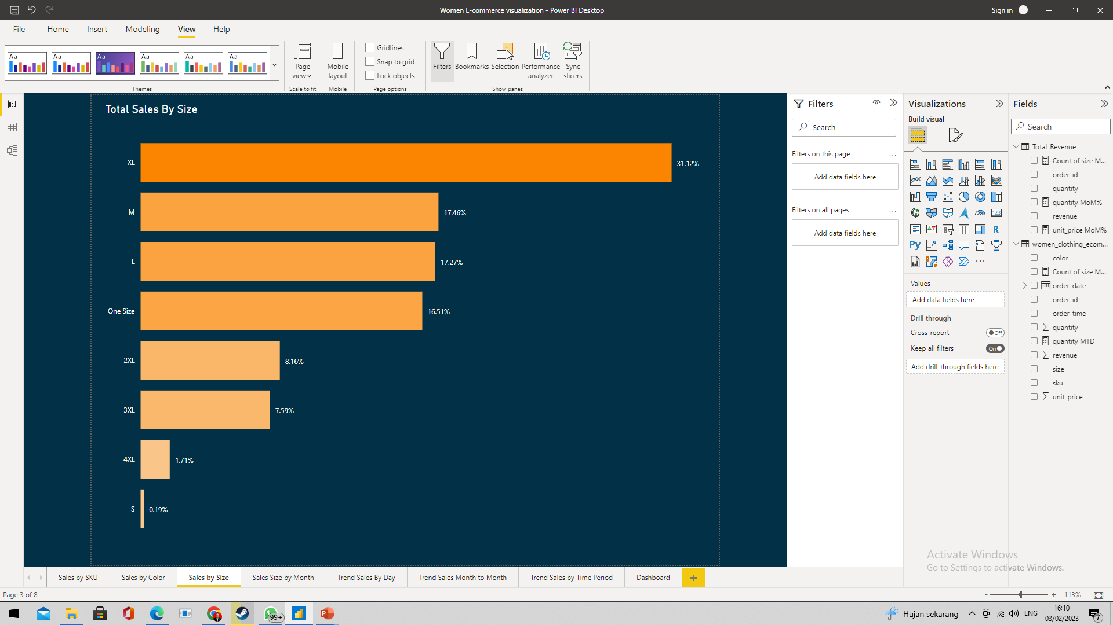
SALES PERFORMANCE BY SIZE

Slide 13
SALES PERFORMANCE BY SIZE - FINDINGS
The bar for size XL is the longest on the chart with a value of 31,12%. indicating that it has the highest sales among all the size. Followed by size M 17,46%, size L 17,27%, and One Size 16,51%.
The bar for size S is the shortest on the chart with a value of 0,19%. Indicating that it has the lowest sales among all the size.

Slide 14
SALES PERFORMANCE BY SIZE - RECOMMENDATION
Ensure that the supply chain for XL and other high-performing sizes is optimized to meet increasing demand and prevent stock shortages.
Conduct market research to better understand why size S is not selling well. This could involve surveying customers, analyzing competitor offerings, or reviewing sales data. If the research indicates that there is limited demand for size S, consider discontinuing this size or adjusting the product line to better align with customer needs.

Slide 15
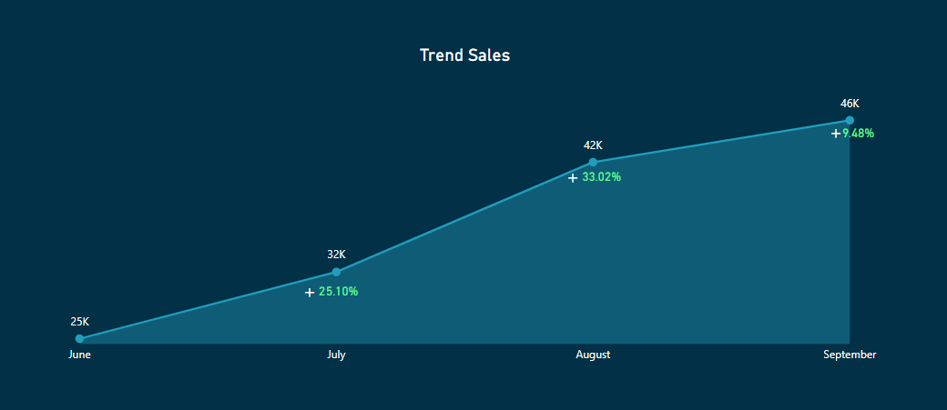
GROWTH SALES BY PREVIOUS MONTH

Slide 16
GROWTH SALES BY PREVIOUS MONTH - FINDINGS
The Graph shows a consistent increase over time, this is considered positive growth and indicates a successful business performance.
The highest growth rate occurred in August at 33,02%.
The lowest growth rate occurred in September at 9,48% but had the largest revenue 46k.

Slide 17
GROWTH SALES BY PREVIOUS MONTH - RECOMMENDATION
Invest in marketing efforts to reach new customers and maintain the positive growth trend.
Consider expanding the product line to increase revenue and capitalize on the positive growth trend.

Slide 18
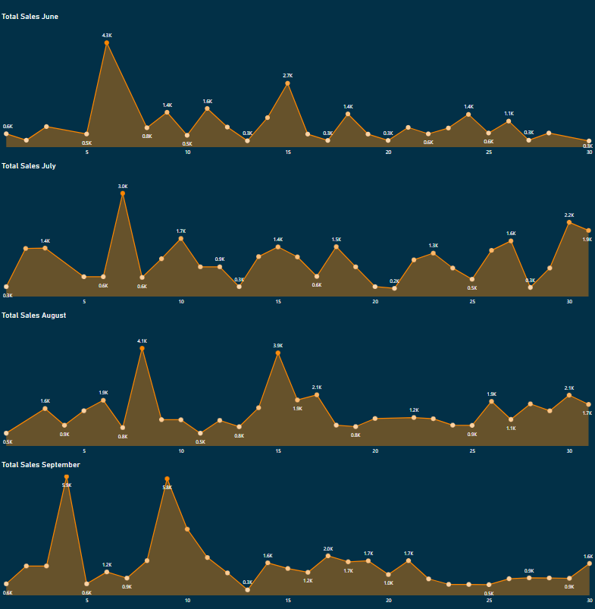
TREND SALES BY DAY

Slide 19
TREND SALES BY DAY - FINDINGS
The Graph show that around the beginning of the second week there was a consistent increase in sales.
The Graph shows variations over time, this could be due to seasonal trends, such as increased sales during holiday periods or slower sales during the end of months.

Slide 20
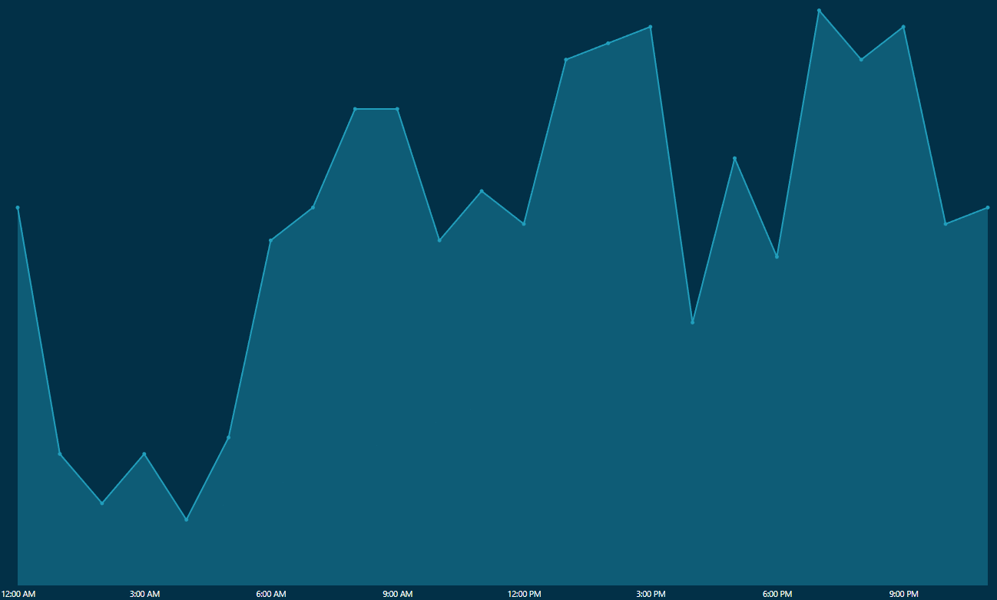
TREND SALES BY TIME PERIOD

Slide 21
TREND SALES BY TIME PERIOD - FINDINGS
The Graph shows variations over time, this could be due to seasonal trends, such as slower sales during working hours and increased sales during break/rest hours.
From the graph it shows that the highest sales peaks occur at 7-9 pm, 1-3 pm, and 7-8 am.

Slide 22
TREND SALES BY DAY AND TIME PERIOD - RECOMMENDATION
Plan marketing and production efforts to take advantage of peak periods of high demand.
Consider reducing production and marketing efforts during low demand periods to reduce costs.
Plan inventory management strategies to ensure adequate supply during peak periods.

Slide 23
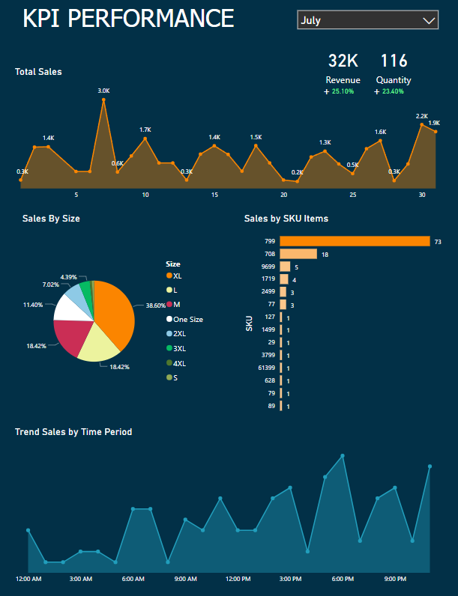
DASHBOARD

Slide 24
CONCLUSION
SKU 799 and 708 are performing the best in terms of sales, followed by the XL size option.
The color dark blue is the most popular color among customers.
While the graph shows positive growth and a consistent increase in sales every month. There are variations in trend sales by days/times which could be due to seasonal trends, however, the business is performing well overall.
The company may want to promoting and investing in the marketing of the top-performing SKUs and colors.

Slide 25
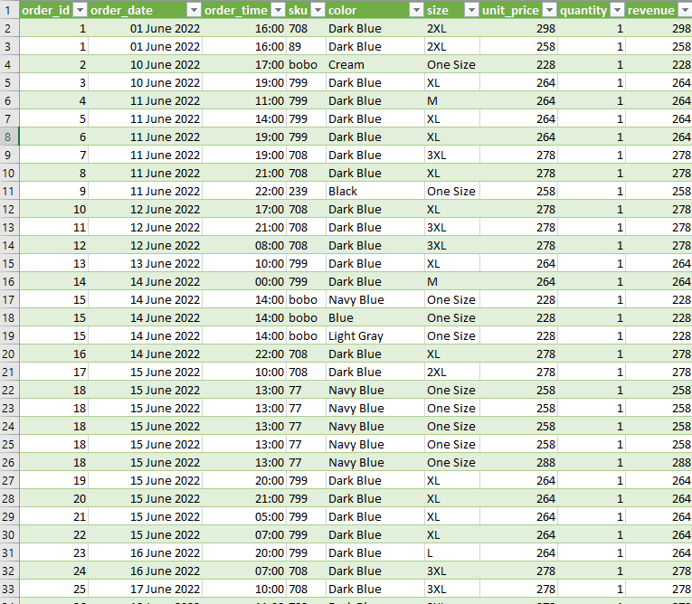
APPENDIX

Slide 26
APPENDIX
Link of dataset : https://www.kaggle.com/datasets/shilongzhuang/-women-clothing-ecommerce-sales-data

